Slide 1
Welcome
to
Innojc

Slide 2
Java Programming
By: Partha Saradhi Reddy.W

Slide 3
Introduction of Java:
JAVA: Java is a general purpose, high level, secure, robust and object-oriented programming language.
The father of Java is James Gosling.
Java was developed by Sun Microsystems (Which is now the subsidiary of Oracle) in the year 1995.
Java is Used for: 1.Mobile applications. 2.Web applications. 3.Desktop applications. 4.Web Servers. 5.Games.

Slide 4
Platform: Any hardware or software environment in which a program runs is known as platform. Eg: OS
Java Platforms / Editions: 1.Java Standard Edition - used for desktop applications. 2.Java Enterprise Edition – used for web applications. 3.Java Micro Edition – used for mobile applications.

Slide 5
Java Version: Many Java Versions have been released till now. The current stable release of java is Java SE 18(March 2022).
Features of Java: 1.Simple. 2.Secure. 3.Object-Oriented. 4.Robust. 5.Interpreted. 6.Multithreaded. 7.Platform Independent.
Types of Software: 1.System software – depends on the software program. 2.Application software – depends on the OS. 3.Internet software – depends on the internet.

Slide 6
Java Setup: Download Java SE 8: https://www.oracle.com/in/java/technologies/javase/javase8-archive-downloads.html Download Eclipse IDE (2019-12): eclipse.org/packages/releas/downloadse/2019https://www.eclipse.org-12/r

Slide 7
Introduction of Testing:
Testing: Testing is the process of executing a program to find the errors.
Testing types: 1)Manual testing. 2)Automation testing.
Why Automation Testing: To achieve the limitations of regression testing.

Slide 8
Smoke testing: Smoke testing is a testing method that determines weather the employed build is stable or not.
Sanity testing: Sanity testing is a subset of regression testing. Sanity testing is performed to ensure that the code changes that are made are working as properly.
Regression testing: Regression testing is a software testing to confirm that a recent program or code changes has not adversely affect on the existing features.
Retesting: Retesting is a procedure where we need to check that particular test cases which are found with some bugs during the execution time.

Slide 9
Why Seleniun: 1.It supports multiple languages like c, c#, python and Java. 2.It supports multiple browsers. 3.It supports multiple operating systems like windows, linux, Mac. 4.It is open source.
Open Source: The actual code that is publicly available.
During compilation of java, the program converts into byte code.
Java is interpreted and multithreaded.
Java has its own memory called Heap memory

Slide 10
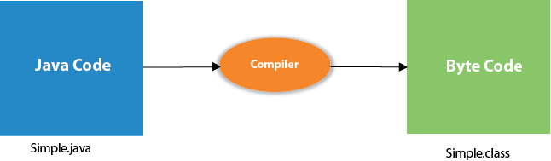
Java first program: public class Main { public static void main(String[] args) { System.out.println(“Hello World”); } }

Slide 11
public: public keyword is an access modifier that represents visibility. It means it is visible to all.
Class: class keyword is used to declare a class in Java.
static: static is a keyword. If we declare any method as static, it is known as the static method.
Void: void is the return type of the method. It means it doesn't return any value.
System.out.println(): System.out.println() is used to print statement.

Slide 12
Variables and its types: A variable is the name of a reserved area allocated in memory. There are three type of variables. 1.Local variable. 2.Instance variable. 3.Static variable.
Local variable: A variable declared inside the body of method is called a local variable. A local variable cannot be defined with “static” keyword.
Instance variable: A variable declared inside the class but outside the body of method is called instance variable. It is not declared as static.
Static variable: A variable that is declared as static is called a static variable. It cannot be local. Static variable is stored in the stack memory, but stack memory is a part of heap memory.

Slide 13
package basics;
public class Variables {
int sum = 10; //instance variable
static int sum1 = 15; //static variable
public void samplemethod() {
int num = 20; //local variable
}
public static void main(String[] args) {
}
}

Slide 14
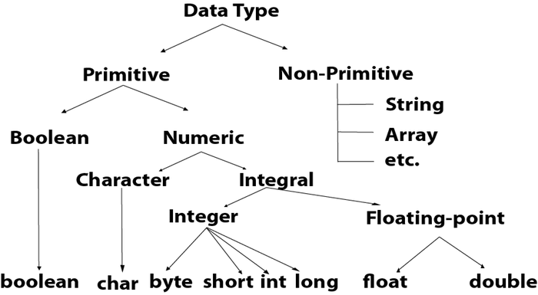
Data types: Data types specify the different sizes and values that can be stored in the variable. There are two types of datatypes in java. 1.Primitive datatypes. 2.Non-primitive datatypes.

Slide 15
package basics;
public class Datatype {
public static void main(String[] args) {
int a = 20;
char ch = '@';
boolean rev = true;
float b = 5.345f;
double db = 34.9874d;
byte c = 23;
long ln = 343453454; Output:20
short sh = 3452; 5.345f
System.out.println(a);
System.out.println(b);
}
}

Slide 16
String: In java, string is an object that represents a sequence of characters. The java.lang.String is used to create a java object. There are two ways to create a string object. 1.By string literal. 2.By new keyword. It is a unique datatype. It is an immutable object. String str = “Hello” String str1 = new String(“hi”);

Slide 17
Arrays: Combines the group of values to a single variable. String[] str = {“Telugu”, “Hindi”, “English”, “Maths”, “Science”, “Social”};
If we want to add class declaration for existing array, we need to fix indexes. String[] str1 = new String[3]; str1[0] = “Commerce”; str1[1] = “Biology”; str1[2] = “Chemistry”;
To find length: System.out.println(str.length);

Slide 18
Comments: Comments are used to explain java code and make it more readible. There are two types of comments. 1.Single line comment: // This is the comment 2.Multi line comment: For shorter: // This is the comment // For longer: /* This is the comment */

Slide 19
Types of Declarations: 1.Lateral declaration: Lateral declaration is stored in SPA (String Pool Area). String str = “true”; // Lateral declaration 2.Class declaration: Class declaration is stored in heap memory. String str1 new String(“Hi”); // Class declaration
SPA is also a part of heap memory.

Slide 20
Conditional Statements
1) If statement:
package statements;
public class Conditions {
public static void main(String[] args) {
int i = 5;
if(i > 2) {
System.out.println("Hello");
}
}
}
2) If-else statement: If condition fails, then use ‘else’.
package statements;
public class Conditions {
public static void main(String[] args) {
int i = 5;
if(i < 2) {
System.out.println("Hello");
} else {
System.out.println("World");
}
}
}

Slide 21
3)Neated-if: A condition in condition.
package statements;
public class Conditions {
public static void main(String[] args) {
int custexp = 10;
String custype = "pre";
if(custexp >= 10) {
if(custype.equals("pre")) {
System.out.println("eligibility for the offer of 10 + 2 %!!!!!!");
} else {
System.out.println("eligibility for the offer 10%!!!!");
}
} else {
System.out.println("eligibility for the offer 5%!!!!!");
}
}
}

Slide 22
4) If-else-if: int marks = 40; if(marks > 90) { System.out.println(“Excellent”); } else if(marks > 70) { System.out.println(“Good”); } else if(marks > 50) { System.out.println(“Poor”); } else { System.out.println(“Fail!!!!!!”); } } }
5) Switch statement: String sub = “English”; switch(sub) { case “Maths”: System.out.println(“MPC”); break; case “Science”: System.out.println(“BiPC”); break; default: System.out.println(“FAIL!!!!!”); } } }

Slide 23
Loops: There are three types of loops in java. 1.For-loop. 2.While loop. 3.Do-while loop. 1.For-loop: Java for loop is used to iterate a part of the program several times. There are three types for for-loops. A)Simple for loop: for() { } packages basics; public class Loopstatements { public static void main(string[] args) { for(int i = 0; i < 5; i++) { System.out.println(i); } } }

Slide 24
B)for-each loop: To iterate fast.
String[] str = {"telugu", "hindi", "english", "maths", "science", "social"};
for(int i = 0; i <= 5; i++) {
System.out.println(str[i]);
}
System.out.println("***Backward***");
for(int i = 5; i >= 0; i--) {
System.out.println(str[i]);
}
for(String str1:str) {
System.out.println(str1);
}

Slide 25
C)Labelled for loop:
String[][] str = {{"telugu", "1"}, {"Hindi", "2"}};
outer:
for(int i = 0; i < str.length; i++) {
for(int j = 0; j < str[i].length; j++) {
System.out.println(str[i][j]);
break outer;
}
}

Slide 26
While loop: The Java while loop is used to iterate a part of the program repeatedly until the specified Boolean condition is true.
package basics; public class Loopstatements { public static void main(String[] args) { int i = 3; while(i < 6) { System.out.println(i); i++; } } }
Do-while loop: To execute atleast one time before checking the condition.
int i = 3;
while(i > 6) {
System.out.println(i);
i++;
}
do {
System.out.println(i);
} while(i > 6);
}

Slide 27
Access modifiers: Access modifiers are used to restrict the scope of class, method, variable or constructor.
In java there are four types of access modifiers.
They are:
1.Public.
2.Private.
3.Protected.
4.Default.

Slide 28
OOPS (Object Oriented Programming System)
Oops: These are pillars of java. Oops is a methodology to design a program using classes and objects. Oops contain: 1.Object. 2.Class. 3.Inheritence. 4.Polymorphism. 5.Abstraction. 6.Encapsulation.
Object: An entity that has state and behaviour is known as object. It can be physical as well as logical entity.
Class: Group of objects is known as class. It is a logical entity.

Slide 30
Inheritence: Acquiring all the properties from one class to another class is known as Inheritence. 1) Why we use inheritance: a.For method overriding. b.For code reusuability. 2) Superclass: Super class is a class from where subclass inherits the features. It is the parent class. 3) Subclass: Subclass is a class which inherits the other class. It is the child class. 4) Syntax: public sub-class name extends super-class name { // methods and variables } 5) extends keyword: extend keyword indicates that you are making a new class that that are derives from existing class.

Slide 31
Encapsulation: Encapsulation is the process of wrapping of code and data together into a single unit.

Slide 32
Multiple inheritance is not supported in java for class but it is supported for interface.
package inheritence;
public class Admin extends Develop {
public void manage() {
super.read();
write();
System.out.println("manage code");
}
public void read() {
System.out.println("admin read code updated");
}
}

Slide 33
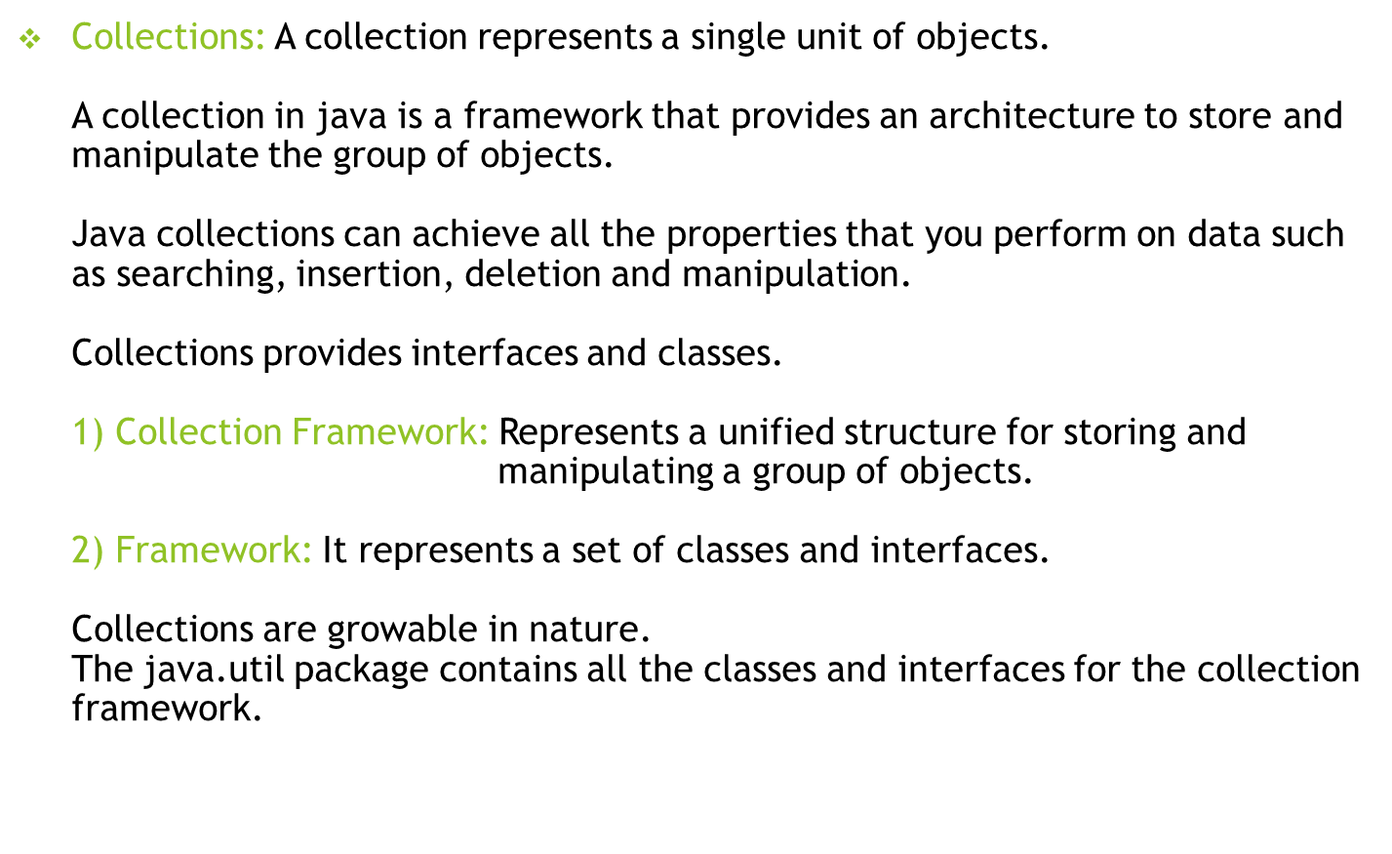

Slide 34
Lists(Collection)
Lists: 1.It is the child interface of collection interface. 2.Ordered collection of objects. 3.Have duplicate values. 4.ArrayList, LinkedList, Vector and Stack.
To initiate the list interface: List<>datatype> list1 = new ArrayList<>();
1) ArrayList: 1.Maintains the insertion order. 2.Uses a dynamic array. 3.non-synchronized. 4.Elements stored in the ArrayList can be randomly accessed. 5.Manipulation is slow.

Slide 35
2) LinkedLists: But in LinkedList the manipulation is fast because there is no shifting. It is used to store the elements in the doubly linkedlists.
ArrayList<String> list1 = new ArrayList<>();
LinkedList<String> list = new LinkedList<>();
list.add("tel");
list.add("hin");
list.add("eng");
list.add("math");
list.add("sci");
list.add("soc");
// System.out.println(list.contains("hin"));
list.remove(1);
System.out.println(list.contains(list.remove(1)));
System.out.println(list);

Slide 36
3) Vector: 1.Uses a dynamic array to store the values. 2.It is synchronized. 3.It is a legacy class. 4.It contains many methods that are not a part of collection framework.
Syntax: Vector<data-type> list = new String<data-type>();
4) Stack: 1.The stack is the subclass of Vector. 2.It implements the last-in-first-out data structure. 3.The stack contains all of the methods of Vector class and also provides its methods like boolean push(), boolean peek(), boolean push(object o), which defines its properties.
Syntax: Stack<data-type> list = new Stack<data-type>();
POP: To remove a value. list.pop(); PUSH: To add a value. List.push(index); pop is used to remove the first element of the stack.

Slide 37
Set(Collection)
Set: 1.It is present in java.util package. 2.It is an unordered collection. 3.It doesn’t allow to store duplicate elements. 4.We can store atmost one null value in a set. 5.Set is implemented by HashSet, LinkedHashSet and TreeSet.
Set can be instantiated as: 1.Set<data-type> s1 = new HashSet<data-type>(); 2. Set<data-type> s2 = new LinkedHashSet<data-type>(); 3. Set<data-type> s3 = new TreeSet<data-type>();

Slide 38
HashSet: 1.HashSet class implements Set Interface. 2.It represents the collection that uses a hash table for storage. 3.Hashing is used to store the elements in the HashSet. 4.It contains unique items.
HashSet<String> list = new HashSet<String>();
list.add("telugu");
list.add("hindi");
list.add("english");
list.add("maths");
list.add("science");
list.add("science");
System.out.println(list);

Slide 39
2) LinkedHashSet: 1.It stores the values in the insertion order.
LinkedHashSet<String> list = new LinkedHashSet<String>();
list.add("Telugu");
list.add("Hindi");
list.add("English");
list.add("Maths");
list.add("Science");
list.add("Social");
list.add("Social");
System.out.println(list);
list.remove("Telugu");
System.out.println(list);

Slide 40
3) TreeSet: 1.It insert the values in the ascending order. 2.Maintains ordered collection. 3.Manipulation is quite fast. 4.It also contains unique elements.
TreeSet<String> list = new TreeSet<String>();
list.add("Telugu");
list.add("Hindi");
list.add("English");
System.out.println(list);
list.remove("Telugu");
System.out.println(list);

Slide 41
Queue(Collection)
Queue: 1. Queue interface maintains the first-in-first-out order. 2.It can be defined as an ordered list that is used to hold the elements which are about to be processed. 3.There are various classes like PriorityQueue, Deque, and ArrayDeque which implements the Queue interface.
Syntax: Queue<String> q1 = new PriorityQueue();
Queue<String> q2 = new ArrayDeque();

Slide 42
Priority Queue: 1. The PriorityQueue class implements the Queue interface. 2.It holds the elements or objects which are to be processed by their priorities. 3.PriorityQueue doesn't allow null values to be stored in the queue.
PriorityQueue<String> list = new PriorityQueue<String>();
list.add("Telugu");
list.add("Hindi");
list.add("English");
list.add("Maths");
list.add("Science");
list.add("Social");
System.out.println(list);
System.out.println("head:" +list.element());
System.out.println("head:" +list.peek());
System.out.println(list);
System.out.println("head:" +list.poll());
System.out.println(list);

Slide 43
Deque: 1.Deque interface extends the Queue interface. 2.In Deque, we can remove and add the elements from both the side. 3.Deque stands for a double-ended queue which enables us to perform the operations at both the ends.
Deque can be instantiated as: Deque d = new ArrayDeque(); 2) ArrayDeque: 1. ArrayDeque class implements the Deque interface. 2.It facilitates us to use the Deque. Unlike queue, we can add or delete the elements from both the ends.

Slide 44
package collections;
import java.util.ArrayDeque;
public class Listsinterface {
public static void main(String[] args) {
ArrayDeque<String> list = new ArrayDeque<String>();
list.add("Telugu");
list.add("Hindi");
list.add("English");
list.add("Maths");
list.add("Science");
list.add("Social");
System.out.println(list);
list.peekFirst();
System.out.println(list);
list.pollFirst();
System.out.println(list);
}
}

Slide 45
Map Interface
Map Interface: 1. A map contains values on the basis of key, i.e. key and value pair. 2.Each key and value pair is known as an entry. 3.A Map contains unique keys. 4.A Map is useful if you have to search, update or delete elements on the basis of a key. 5. A Map doesn't allow duplicate keys, but you can have duplicate values 6. HashMap and LinkedHashMap allow null keys and values, but TreeMap doesn't allow any null key or value. 7. There are two interfaces for implementing java map i.e, Map and SortedMap and there are three classes called HashMap, LinkedHashMap and TreeMap.

